Slide 1
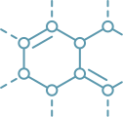
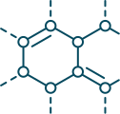
THE HISTORICAL DEVELOPMENT, EVOLUTION, AND IMPACT OF DRUG DELIVERY SYSTEMS.

Slide 2
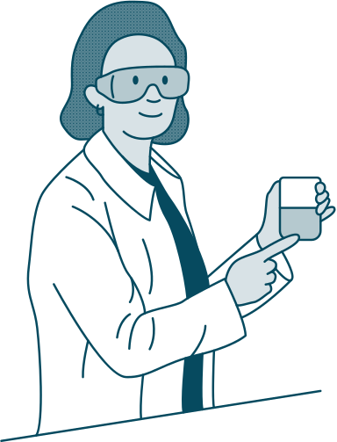
Introduction
Drug delivery is the transportation of a theraputic agent into the body to achieve a desired effect to help prevent the disease spreading to you. This system has been very successful in curing diseases because it allows it to target certain areas in you body and have a slow reaction time for less side effects.
Read More

Slide 3
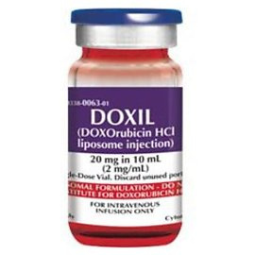
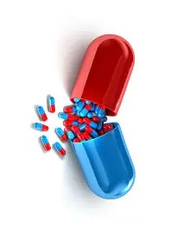
Development of drug delivery systems
We first relied on plants, herbs and animal products to cure us
One of the first controlled release systems produced in 1952 called Spanules
Doxil has been used clinically to target specific tumors in cancer patients and reduce side effects

Slide 4

Impact of drug delivery systems
Advantages:
  reduction in toxicity
  less side effects
  reduction in healthcare monitoring
  decrease in administration costs
Disadvantages:
  Skin irritation from transdermal patches
  Restrictions on drug loading capacity
  Complex manufacturing

Slide 5
Future developments and challenges
  Covid 19 vaccine
  Nanotechnology - release of drug where needed
  AI use - personalize medicine
  3D printing - manufacture tablets,implants and devices
Challenges:
  Costly
  Time-consuming
  Difficulty approving pharmaceutical datasets with AI

